Slide 1
Course : Computational Biology
Effective Period : June 2022
Sequence Alignment Using Biopython Session 4

Slide 2
Objective and Outline
LO : Execute a planned simulation of Introduction to BioPython, DNA Sequence Analysis, and DNA Sequence Alignment
In this course we will be simulating basic Bioinformatics analysis using Biopython. Although the Python part is dominant, this course is still ideal for students only with a basic knowledge of biology. The course contains a basic introduction to the Jupyter Notebook and Colab Environment,
In this session, we will start exploring a simulation concept using Open-Source Biopython
Official Website : https://biopython.org/
Outline
Global and Local Alignment
Similarity Analysis
Humming Distance, Levenstein Distance, and Dot Plot

Slide 3
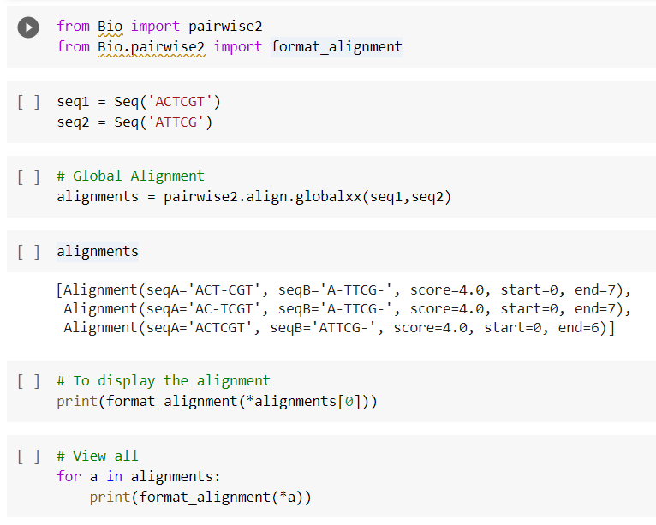
Global and Local Alignment
Sequence alignment is a method of arranging sequences of DNA, RNA, or Amino Acids or proteins to identify regions of similarity.
Similarity: Degree of likeness between two sequences, usually expressed as a percentage of similar (or identical) residues over a given length of the alignment. Can usually be easily calculated.
Homology: Statement about common evolutionary ancestry of two sequences. Can only be true or false. We can rarely be certain about this, it is therefore usually a hypothesis that may be more or less probable.
A high degree if similarity implies a high probability of homology

Slide 4
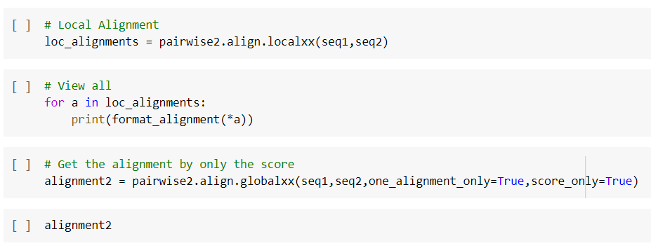
Global and Local Alignment
When to use local alignment
2 sequences have a small matched region
2 Sequences are of different lengths
Overlapping sequences
One sequences is a subsequences of the other

Slide 5
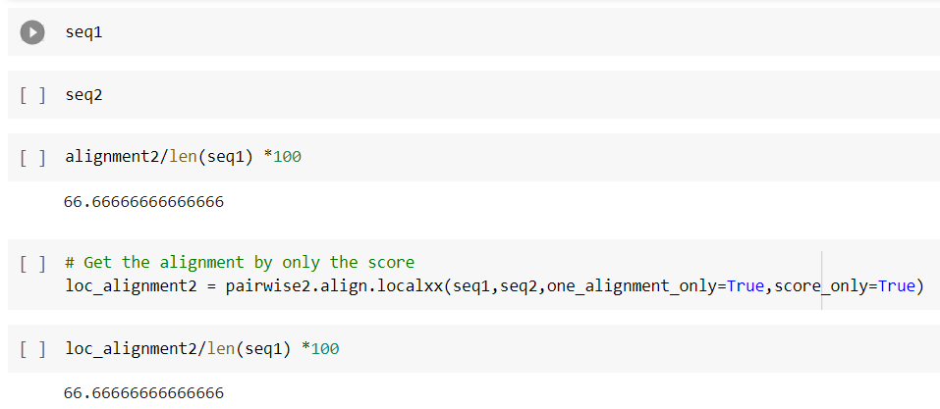
Similarity Analysis
Check for similarity or
percentage of similarity
using Alignment
(fraction of nucleotides that is the same) /
(total number of nucleotides) * 100%

Slide 6
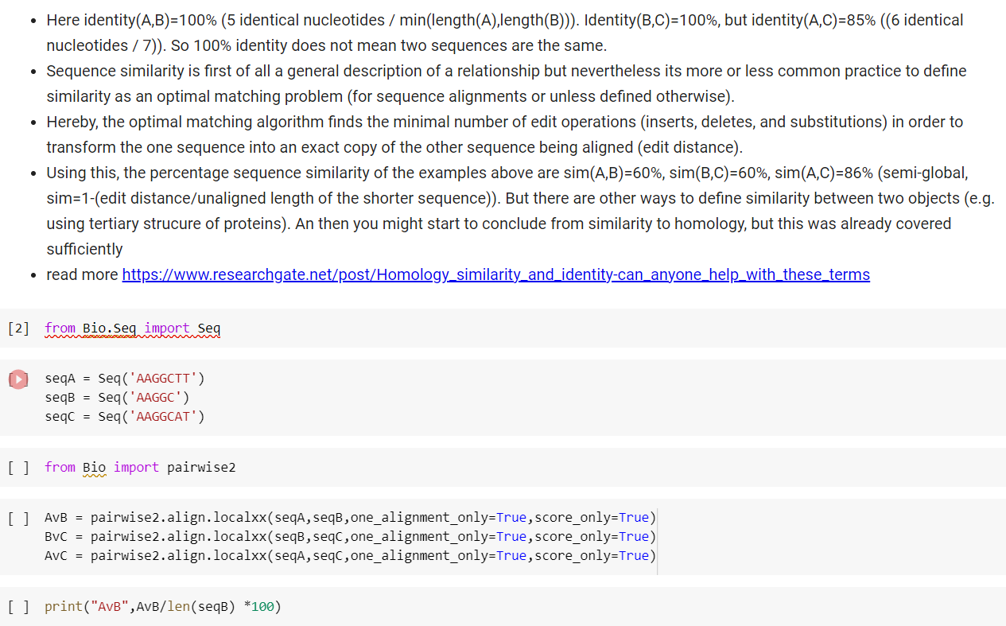
Similarity Analysis
Check for similarity or percentage of
similarity using Alignment
the minimal number of edit operations (inserts, deletes, and substitutions) in order to transform the one sequence into an exact copy of the other sequence being aligned
Distance
Identity: the number of characters that match EXACTLY between two different sequences
Gaps are not counted
The measurement is relational to the shorter of the two sequences.
This has the effect that sequence identity is not transitive, i.e.
if sequence A=B and B=C then A is not necessarily equal C (in terms of the identity distance measure) :

Slide 7
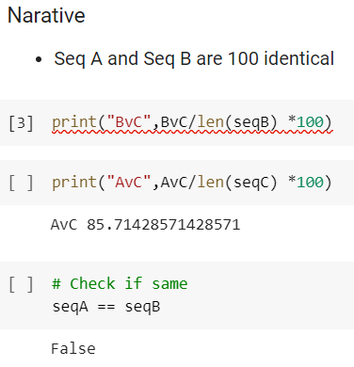
Similarity Analysis
Check for similarity or percentage of
similarity using Alignment
the minimal number of edit operations (inserts, deletes, and substitutions) in order to transform the one sequence into an exact copy of the other sequence being aligned
Distance
Identity: the number of characters that match EXACTLY between two different sequences
Gaps are not counted
The measurement is relational to the shorter of the two sequences.
This has the effect that sequence identity is not transitive, i.e.
if sequence A=B and B=C then A is not necessarily equal C (in terms of the identity distance measure) :

Slide 8
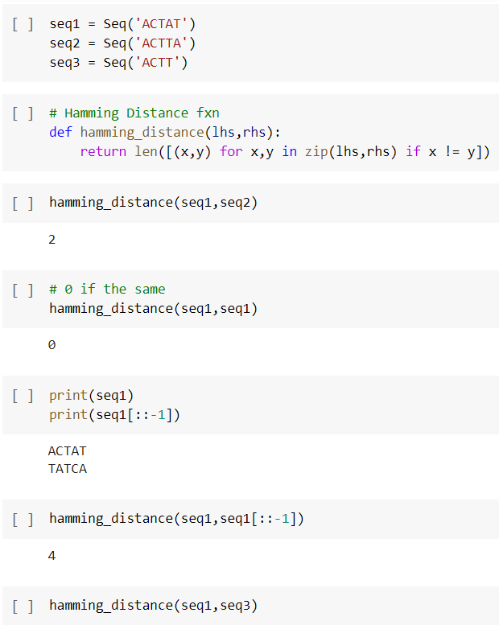
Hamming Distance, Levenstein Distance, and Dot Plot
Hamming distance: shows how many places 2 strings differ
Hamming distance between two strings of equal length is the number of positions at which the corresponding symbols are different.
In other words, it measures the minimum number of substitutions required to change one string into the other, or the minimum number of errors that could have transformed one string into the othe
It is used for error detection or error correction
It is used to quantify the similarity of DNA sequences,

Slide 9
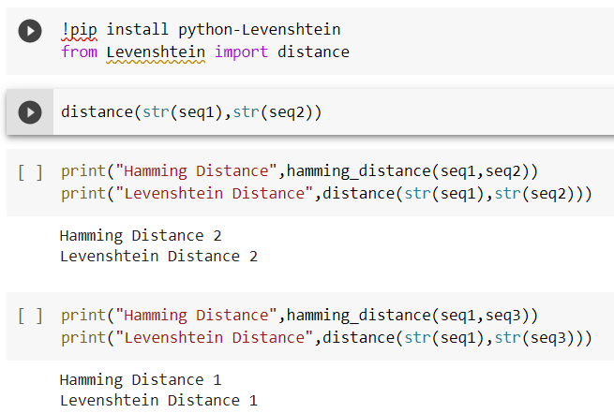
Hamming Distance, Levenstein Distance, and Dot Plot
Levenshtein distance : This method was invented in 1965 by the Russian Mathematician Vladimir Levenshtein (1935-2017).
The distance value describes the minimal number of deletions, insertions, or substitutions that are required to transform one string (the source) into another (the target)
Unlike the Hamming distance, the Levenshtein distance works on strings with an unequal length

Slide 10
Hamming Distance, Levenstein Distance, and Dot Plot
Dot Plot
A dot plot is a graphical method that allows the comparison of two biological sequences and identify regions of close similarity between them.
Simplest method - put a dot wherever sequences are identical
Dot plots compare two sequences by organizing one sequence on the x-axis, and another on the y-axis, of a plot.
When the residues of both sequences match at the same location on the plot, a dot is drawn at the corresponding position usefulness
Dot plots can also be used to visually inspect sequences for : direct or inverted repeats; regions with low sequence complexity; Similar regions; Repeated sequences; Sequence rearrangements; RNA structures; Gene order
Link :
https://stackoverflow.com/questions/40822400/how-to-create-a-dotplot-of-two-dna-sequence-in-python

Slide 11
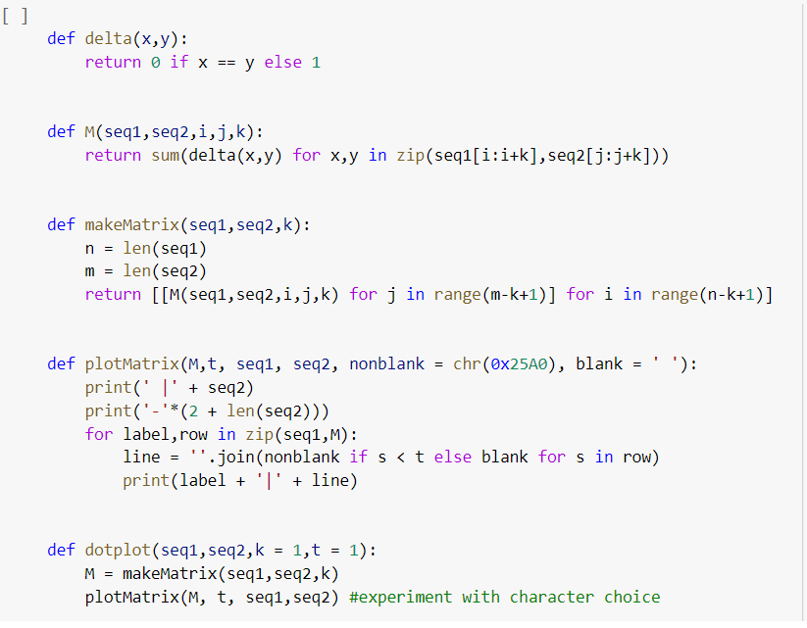
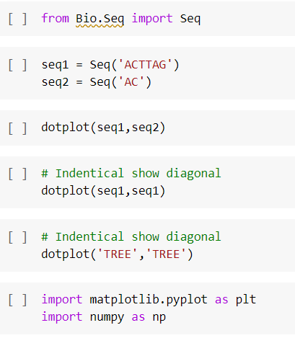
Hamming Distance, Levenstein Distance, and Dot Plot
Define the function
Run dotplot function

Slide 12
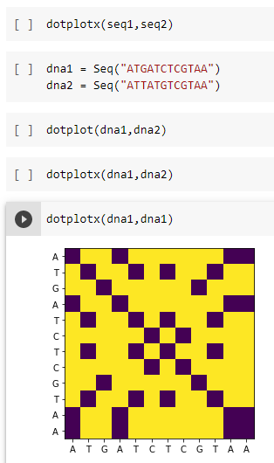
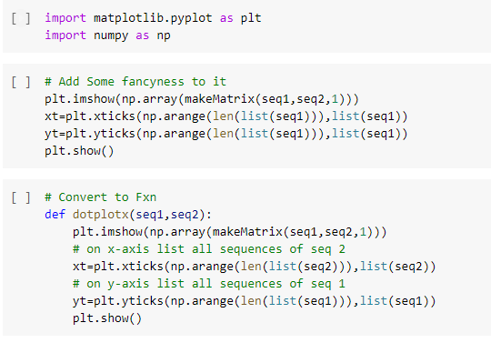
Dot Plot

Slide 13
Exercise
Given 2 sequences :
Seq 1 = 'ATGCATGGTGCGCGA’
Seq 2 = 'ATTTGTGCTCCTGGA’
Which alignment would be suitable for the two sequence?
Find similarity percentage between the two sequence
Check similarity using Hamming Distance, Levenstein Distance, and Dot Plot

